Slide 1






Enhanced environmental protection inspection for efficient control of air quality monitoring and of all entities under obligation within system of greenhouse gas emission allowance trading, in order to achieve better quality of air in Republic of Croatia
This project is funded by the European Union

Slide 2



THEME 2: Pollutants

Slide 3
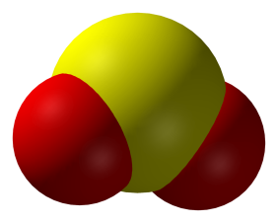

2.1 SO₂ – CHEMICAL CHARACTERISTICS
European Union IPA 2013 Programme for Croatia
Sulphur dioxide (SO₂) is a colourless gas that most people can smell it in the range of concentration of 1000 to 3000 μg/m³ of air. At higher concentrations (above 10 000 μg/m³ air) the smell of him is irritating.

Slide 4
2.2 SO₂ – CHEMISTRY OF PRODUCTION AND DEGRADATION
European Union IPA 2013 Programme for Croatia
Released into the atmosphere, sulphur (S) reacts with oxygen (O₂) and produced sulphur dioxide (SO₂):
S + O₂  SO₂
Sulfur dioxide (SO₂) in the atmosphere can also occur by oxidation of hydrogen sulphide (H₂S):
2H₂S + 3O₂  2SO₂
SO₂ can be dissolved in the water and in the form of water vapor or rain in the atmosphere forming sulphurous acid (H₂SO₃):
SO₂ + H₂O  H₂SO₃

Slide 5
2.2 SO₂ – CHEMISTRY OF PRODUCTION AND DEGRADATION
European Union IPA 2013 Programme for Croatia
SO₂ can also be oxidized or reacted in the atmosphere in catalytic or photochemical reactions with other air pollutants. Sulfur trioxide, sulfuric acid and sulfates are produced from such reactions:
2SO₂ + O₂  2SO₃
Sulphur trioksid (SO₃) is a very reactive gas and in the presence of water vapor in the air very quickly hydrates in sulfuric acid (H₂SO₄).
SO₃ + H₂O  H₂SO₄

Slide 6
2.2 SO₂ – CHEMISTRY OF PRODUCTION AND DEGRADATION
European Union IPA 2013 Programme for Croatia
Sulfuric acid can react with other components of air, products sulfate.
Some sulphates are emitted into the air from industrial plants, but also from natural sources such as volcanic eruptions.

Slide 7
2.2 SO₂ – CHEMISTRY OF PRODUCTION AND DEGRADATION
European Union IPA 2013 Programme for Croatia
Natural sources
Sulphur compounds in the unpolluted air is located in very small concentrations. In the air can be found in:
Gaseous phase (H₂S) i (SO₂)
Shape of the particles as sulphates.
Sulphur dioxide and hydrogen sulphide into the atmosphere are emitted during the volcanic eruptions or from the soil in which occur as a result of the metabolism of anaerobic bacteria.
In the form of sulphate particles can also be emitted directly out of a volcano, or carried by the wind from the ocean surface.

Slide 8
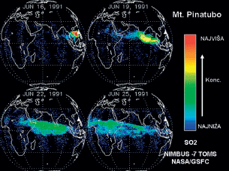
2.2 SO₂ – CHEMISTRY OF PRODUCTION AND DEGRADATION
European Union IPA 2013 Programme for Croatia
Natural sources (example)
After the eruption of the volcano Mt. Pinatubo in the Philippines, 1991. the cloud which contained SO₂ in the next 10 days spread over half of the equatorial part reaching to the west coast of Africa. Source: NASA.

Slide 9
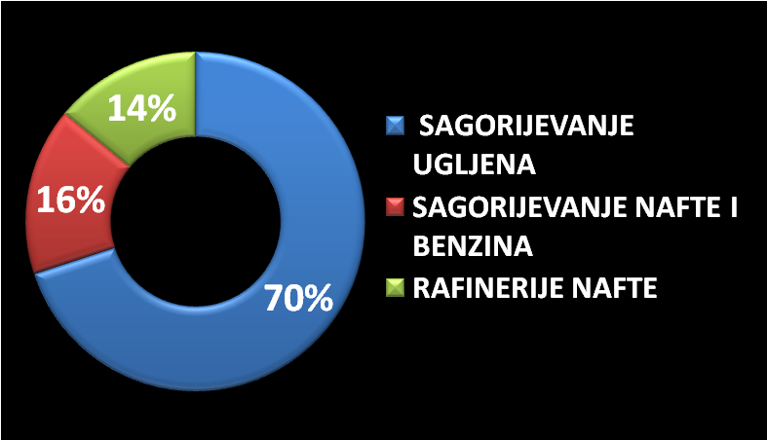
2.2 SO₂ – CHEMISTRY OF PRODUCTION AND DEGRADATION
European Union IPA 2013 Programme for Croatia
Anthropogenic sources
Anthropogenic sources of sulfur compounds are the most common from combustion of fossil fuels in factories for the production of energy for heating and motor vehicles.
coal burning
oil and gasoline burning
oil refineries

Slide 10
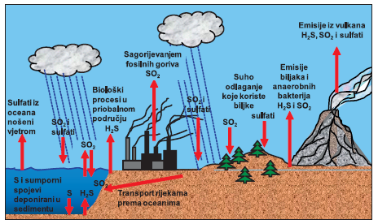
2.2 SO₂ – CHEMISTRY OF PRODUCTION AND DEGRADATION
European Union IPA 2013 Programme for Croatia
Natural and anthropogenic sources
Sources and locations of plunging sulfur compounds in the biosphere.

Slide 11
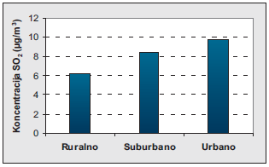
2.3 SO₂ – SPATIAL AND TEMPORAL DISTRIBUTION
European Union IPA 2013 Programme for Croatia
The average annual value of the concentration of SO₂ are categorized according to the location:
The improvement of air quality (refers to the concentration. SO₂) in Europe in the last few decades is the result of the implementation of the national and international regulations.

Slide 12
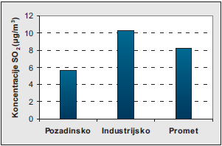
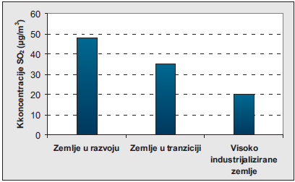
2.3 SO₂ – SPATIAL AND TEMPORAL DISTRIBUTION
European Union IPA 2013 Programme for Croatia
With regard to the source of pollution, the largest proportion of SO₂ in the air comes from the industry, and then from the traffic.
On a global level, the concentration of SO₂ in air significantly differ depending on the industrial development of countries. Most are in developing countries, slightly less in the transition countries, and lowest in the highly industrialized countries.
background
industry
traffic
developing countries
countries in transition
highly industrialized countries

Slide 13
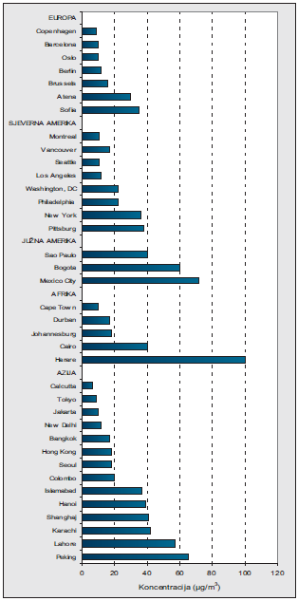
2.3 SO₂ – SPATIAL AND TEMPORAL DISTRIBUTION
European Union IPA 2013 Programme for Croatia
Average annual concentrations of SO₂ in the world in the period of 2002. to 2005. Source: Air quality guidelines – the WHO.

Slide 14
2.4 SO₂ – TOXICOLOGICAL AND PUBLIC HEALTH ASPECTS
European Union IPA 2013 Programme for Croatia
Pathways of SO₂ entry into the body are: RESPIRATORY SYSTEM,
DIGESTIVE SYSTEM,
SKIN
SO₂ is soluble in water and is absorbed through the mucous membranes of the nose and upper respiratory tract.
Example:
The amount of absorption depends on the inhaled concentration of the SO₂.
If you inhale the SO₂ in concentration from 4 to 6 μg/m³ of air, it will be absorbe 85% inhaled SO₂
At concentrations of 46 μg/m³ of air is absorbed 99% SO₂
With increased physical activity at accelerated breathing absorption is moved deeper towards the lower respiratory tract.

Slide 15
2.4 SO₂ – TOXICOLOGICAL AND PUBLIC HEALTH ASPECTS
European Union IPA 2013 Programme for Croatia
Absorption of SO₂ are created sulphite (SO₃²⁻) and bisulphite (HSO₃⁻) ions in the following reactions:
SO₂ + H₂O  H₂SO₃
H₂SO₃ + H₂O  HSO₃⁻ + H₃O⁺
HSO₃ ⁻ + H₂O  SO₃²⁻ + H₃O⁺
Sulfite and bisulphite ions bind to nerve receptors in the upper and middle airways. They are irritant and come into contact with the airway (bronchoconstriction). Bronchoconstriction is the result of muscle contraction which carries the mucous membrane.

Slide 16
2.4 SO₂ – TOXICOLOGICAL AND PUBLIC HEALTH ASPECTS
European Union IPA 2013 Programme for Croatia
The ambient SO₂ concentrations do not constitute a danger to human health, except in places where concentrations are elevated in industrial plants smelter.
An experiment:
It has been done on volunteers - the first symptoms occur when inhaling SO₂ concentrations exceeding 14,000 μg / m³, which are much more than ambient.
The highest measured one-hour average concentration in Europe in the period of 1990. to 1999. was 587 μg/m³, and the highest 24-hour average he had a value of 327 μg/m³.

Slide 17
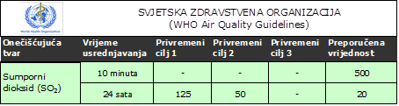
2.4 SO₂ – TOXICOLOGICAL AND PUBLIC HEALTH ASPECTS
European Union IPA 2013 Programme for Croatia
Recommended values (μg/m³), the concentration of sulfur dioxide (SO₂) in the air-the WHO
Pollutant
Averaging time
Temporary goal 1
Temporary goal 2
Temporary goal 3
Recommended value
SO₂
10 min.
24 hours

Slide 18
2.5 – SO₂ MEASUREMENT METHODS
European Union IPA 2013 Programme for Croatia
The reference method for the measurement of SO₂
Ultraviolet (UV) fluorescence
(HRN EN 14212)
Prescribed by regulations of the Republic of Croatia and the European Union. In the European Union and in Croatia, was adopted by 2012.

Slide 19
2.5 – SO₂ MEASUREMENT METHODS
European Union IPA 2013 Programme for Croatia
SO₂ + hv  SO₂*
SO₂*  SO₂ + hv
where SO₂ * is excited state of the molecule
The method is based on fluorescence of the SO₂ molecule if the molecule is exposed to ultraviolet (UV) radiation. Because of exposure to UV radiation the SO₂ molecule switches from normal to excited state and is then returned to normal state by emitted fluorescent radiation.
The intensity of the emitted radiation is proportional to the number of molecules in a given volume of SO₂, or the concentration of the SO₂ molecule in the air.

Slide 20
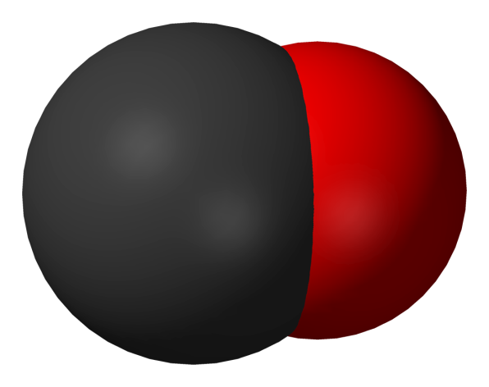
2.1 CO – CHEMICAL CHARACTERISTICS
European Union IPA 2013 Programme for Croatia
Carbon monoxide (CO) gas has no odor, color, and flavor, lighter than air and very poorly soluble in water. At standard conditions of temperature and pressure (25°C, 1 atm) is chemically inert, and becomes at a higher temperature a powerful reducing agent. A life time of a molecule of CO in the atmosphere is 0.2 years.

Slide 21
2.2 CO – CHEMISTRY OF PRODUCTION AND DEGRADATION
European Union IPA 2013 Programme for Croatia
CO is created incomplete combustion of organic substances (substances that contain carbon). Since the gasoline is also organic matter which consists of a mixture of different hydrocarbons, including octane (C₈H₁₈), incomplete combustion of gasoline creates a CO who is found in car exhaust fumes.
If the supply of a car engine with oxygen is sufficient, octane from the gasoline will be fully oxidized and carbon dioxide and water will produce:
Example:
2C₈H₁₈ + 25O₂  16CO₂ + 18H₂O

Slide 22
2.2 CO – CHEMISTRY OF PRODUCTION AND DEGRADATION
European Union IPA 2013 Programme for Croatia
In reality, it is not converted all the carbon in carbon dioxide, is already being created and a certain amount of (about 7%) carbon monoxide. In the extreme situation all the carbon from octane will be converted to carbon monoxide:
2C₈H₁₈ + 17O₂ 16CO + 18H₂O
CO is created on the surface of the Earth diffuses in the upper parts of the troposphere, where with the help of hydroxyl radicals is oxidized into carbon dioxide (CO₂). A certain amount of CO in the atmosphere creates by oxidation biological created methane (CH₄), which is a product of the decomposition of plant and animal residues, but also by a series of chemical reactions with other compounds in the atmosphere.

Slide 23
2.2 CO – CHEMISTRY OF PRODUCTION AND DEGRADATION
European Union IPA 2013 Programme for Croatia
The oceans represent places where CO or releases or plunges into them depending on the conditions prevailing, the partial pressure of CO in the atmosphere, the temperature of the ocean water.
Additional amounts of CO released in the atmosphere from factories, from traffic and forest fires. Microorganisms in the soil can remove a certain amount of CO in the atmosphere because it is spending for its metabolic processes.

Slide 24
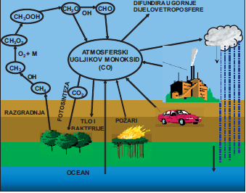
2.2 CO – CHEMISTRY OF PRODUCTION AND DEGRADATION
European Union IPA 2013 Programme for Croatia
Global cycle CO. source: Jain, K.K. 1990. Carbon monoxide poisoning.

Slide 25
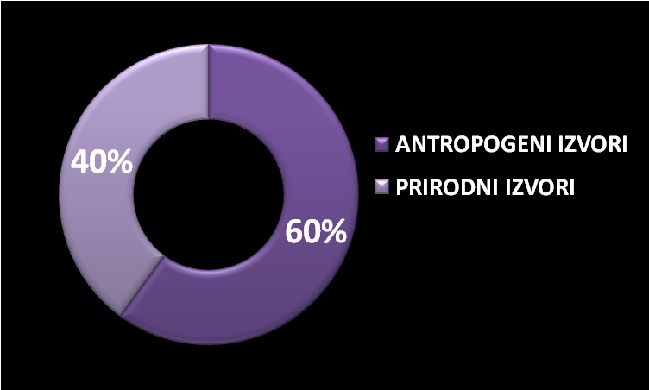
2.2 CO – CHEMISTRY OF PRODUCTION AND DEGRADATION
European Union IPA 2013 Programme for Croatia
Natural and anthropogenic sources
It is estimated that the annual global emissions of CO in the atmosphere are 2600 million tons
BIOLOGICAL plants and oceans
ANTROPOGENIC SOURCES
NATURAL SOURCES
CHEMICAL oxidation of hydrocarbons in the atmosphere
Incomplete combustion of organic substances (transport, industry and households)

Slide 26
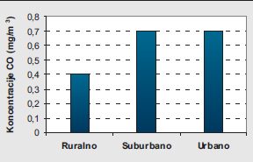
2.3 CO – SPATIAL AND TEMPORAL DISTRIBUTION
European Union IPA 2013 Programme for Croatia
Global background concentrations of CO range from 0.06 and 0.14 mg/m³.
CO concentrations vary with respect to the location of the measurement. So the average annual values of the measured concentration of CO in the area of Europe at the locations of the stations AirBasea range from 0.4 mg/m³ in rural up to 0.7 mg/m³ in urban areas.
The ambient concentration measured in urban areas depend significantly on the density of traffic, topography and weather conditions.

Slide 27
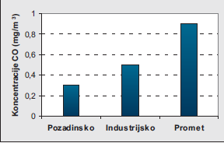
2.3 CO – SPATIAL AND TEMPORAL DISTRIBUTION
European Union IPA 2013 Programme for Croatia
With regard to the source of pollution, the largest proportion of CO in the air comes from the traffic, and then from the industry.
In connection with the traffic , the concentration of CO in the air show a clear diurnal variation with the expressed values of the peak in the morning and in the afternoon, which corresponds to the time when people go to work and return from work.
Background
Industrial
Traffic
They're much higher concentrations of CO from ambient measured in underground garages, tunnels, and other enclosed spaces with inadequate ventilation, as well as in homes, especially kitchens, where it is used city gas (peak concentration was even 60 mg/m³ ).

Slide 28
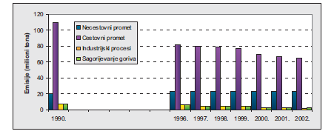
2.3 CO – SPATIAL AND TEMPORAL DISTRIBUTION
European Union IPA 2013 Programme for Croatia
According to the data of EPA, 95% of anthropogenic emissions in the U.S. comes from road traffic, while on the second place there are emissions from the non-road traffic. The rest of the show relate to industrial sources and sources from households.
Non-road traffic
Road traffic
Industry
Combusting

Slide 29
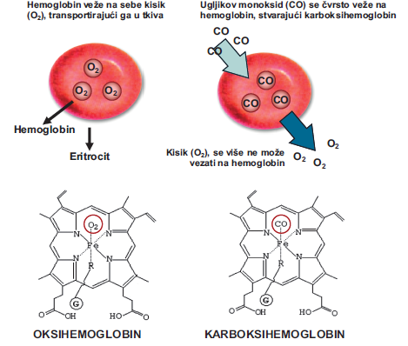
2.4 CO – TOXICOLOGICAL PUBLIC HEALTH ASPECTS
European Union IPA 2013 Programme for Croatia
Since the CO gas stable in the atmosphere, the lungs are the only way of entering the organism. When CO pass alveolar and capillary membrane and enters the bloodstream, would diffuse into the blood cells and binds reversible to a protein on a hem that is an integral part of hemoglobin in erythrocytes on the place where the otherwise binds the oxygen, producing carboxyhemoglobin (COHb).
Since there is an affinity for carbon monoxide to hem 200 to 250 times higher than the affinity of oxygen, in individuals exposed to elevated concentrations of CO, poisoning occurs in very short exposure.

Slide 30
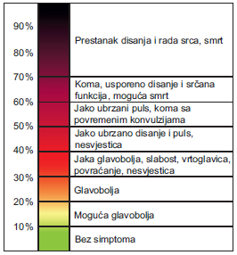

2.4 CO – TOXICOLOGICAL PUBLIC HEALTH ASPECTS
European Union IPA 2013 Programme for Croatia
Poisoning is the result of a lack of oxygen in the tissues (hypoxia). Levels of carboxyhemoglobin is created it can be measured, and he represents a biomarker for determining exposure CO. CO from the body eliminates through the lungs.
Depending on the concentrations of carboxyhemoglobin, poisoning symptoms are different and become more serious with the increase in the concentration of carboxyhemoglobin in the blood. The organs that are the most affected ones are the organs that need oxygen the most for their function: cerebrum, the organs of the cardiovascular system and skeletal muscles.
No breathing and heart work, death
Coma, slow breathing, possible death
Tachycardia and coma
Tachycardia and coma
Headache, dizziness, vomitting
Headache
Possible headache
Institut za energetiku i zaštitu okoliša
No symptoms

Slide 31
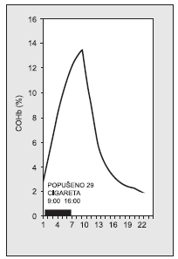
2.4 CO – TOXICOLOGICAL PUBLIC HEALTH ASPECTS
European Union IPA 2013 Programme for Croatia
Non-smokers with the occupations in which they are increasingly exposed to elevated concentrations of CO (professional drivers, traffic police officers, workers in the tunnels and garages, fire brigade, etc.) have a COHb levels permanently greater than 5%, while a larger number of smokers of cigarettes have COHb levels even higher of 13%. By measuring COHb in smokers has found that the percentage of COHb values grow to a value that is larger than 13% if the smoker within 7 hours, smoke a 29 cigarettes. If after this time if they do not smoke another cigarette, elimination of CO related to hemoglobin will be even 15 hours.
Changes in the percentage of COHb values associated with cigarette smoking and the time of elimination of CO from the organism. Source: Landaw 1973.

Slide 32
2.4 CO – TOXICOLOGICAL PUBLIC HEALTH ASPECTS
European Union IPA 2013 Programme for Croatia
Neurological effects
Acute poisoning of carbon monoxide may cause reversible short-term neurological deficit, but also serious neurological damage. At levels above 10% COHb headaches are possible, while at the level of about 40% COHb can occur dizziness and fainting. Psychomotor effects, such as reduced coordination and orientation, may occur at levels of COHb from 5.1 to 8.2%.

Slide 33
2.4 CO – TOXICOLOGICAL PUBLIC HEALTH ASPECTS
European Union IPA 2013 Programme for Croatia
Cardiovascular effects
Patients with cardiovascular disease, especially those with ischaemic heart disease, they are more susceptible to carbon monoxide than healthy people. Narrowing of the coronary arteries due to atherosclerotic change and weakened by the expansion mechanisms reduce the blood supply to the myocardium disabling the physiological compensation for reduced oxygen flow caused by elevated levels of COHb. At the level of 5% COHb in such patients affects cardiac arrhythmias that are more often after physical activity.

Slide 34
2.4 CO – TOXICOLOGICAL PUBLIC HEALTH ASPECTS
European Union IPA 2013 Programme for Croatia
Carcinogens and mutagenic effects
There is no evidence for carcinogenic and mutagenic effects of carbon monoxide that has been entered in the system.

Slide 35
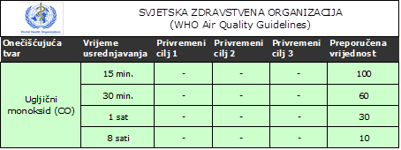
2.4 CO – TOXICOLOGICAL PUBLIC HEALTH ASPECTS
European Union IPA 2013 Programme for Croatia
Recommended values (mg/m³), the concentration of carbon monoxide (CO) in the air-the. WHO
Pollutant
Averaging time
Temporary goal 1
Temporary goal 2
Temporary goal 3
Recommended value
CO
min.
min.
hour
hours

Slide 36
2.5 CO – MEASUREMENT METHODS
European Union IPA 2013 Programme for Croatia
The reference method for the measurement of carbon monoxide
Infrared (IR) spectroscopy (HRN EN 14626)
Prescribed by regulations of the Republic of Croatia and the European Union. In the European Union and Croatia, was adopted by 2012.

Slide 37
2.5 CO – MEASUREMENT METHODS
European Union IPA 2013 Programme for Croatia
The fundamental principle of the method is the possibility of CO molecules to absorb IR-radiation, and as spectroscopic analysis based on the application of the Beer-Lambert law, which describes relationship between the intensity of electromagnetic radiation before and after passing through the sample. The degree of absorption of IR-radiation depends on:
length of the absorption chamber (CO has the highest absorption on the wave length of 4.67 μm)
the absorption coefficient
the concentration of CO in the sample entered in the absorption chamber

Slide 38
2.5 CO – MEASUREMENT METHODS
European Union IPA 2013 Programme for Croatia
Since almost every heteroatomic molecule (especially the H₂O, CO₂, nitrogen oxides and hydrocarbons) absorb IR radiation, to remove interference in the carbon monoxide analysers apply and combine different methods such as:
• measuring of IR-absorption on the length of exactly 4.67 μm
• measuring with the help of two measuring chambers of which one is the reference
• measuring at multiple wavelengths, by applying the gas filter, called a correlation wheel
• drying air before entering into the measuring chamber

Slide 39
2.5 CO – MEASUREMENT METHODS
European Union IPA 2013 Programme for Croatia
If the instrument is calibrated in volume/volume units, the concentration of CO are measured directly in volume/volume units (ppm) because the absorption in the IR spectrum is proportional to the concentration of CO in the volume/volume units.
After that, the obtained concentrations in ppb are converted to mg/m³, using the standard conversation factors for a temperature of 20 ° C and an atmospheric pressure of 1013 hPa.
1 ppm (μmol/mol) CO = 1,16 mg/m³

Slide 40
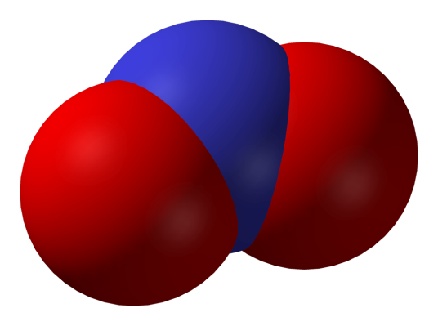
2.1 NO₂ – CHEMICAL CHARACTERISTICS
European Union IPA 2013 Programme for Croatia
Nitrogen dioxide is a reddish-brown gas with a characteristic irritating odor. It is soluble in water, strong oxidant, and has corrosive properties. It plays a role in the global climate change on Earth, and together with nitrogen oxide (NO) is the main regulator of the oxidizing capacity of the troposphere by controlling the destiny of the radicals, including hydroxyl radicals. Due to photolysis in the troposphere, it plays an important role in the photochemical creation of ground-level ozone (O₃).

Slide 41
2.2 NO₂ – CHEMISTRY OF PRODUCTION AND DEGRADATION
European Union IPA 2013 Programme for Croatia
The nitrogen oxides (NOx) in the troposphere, transformed and removed from it through a complex chemical reaction involving and photochemical reactions that create ground level ozone and photochemical smog.
The dominant source of nitrogen oxide in the air are the processes of burning.
90 to 95% of the nitrogen oxides emitted as nitric oxide (NO), and 5 to 10% as nitrogen dioxide (NO₂).

Slide 42
2.2 NO₂ – CHEMISTRY OF PRODUCTION AND DEGRADATION
European Union IPA 2013 Programme for Croatia
Creation of photochemical smog
In the creation of photochemical smog NO from motor vehicles, a starting compound is oxidized to the troposphere by forming nitrogen dioxide (NO₂)
2NO + O₂  2NO₂
The created NO₂ is photolyzed in a photolytic reaction producing nitrogen oxide and oxygen:
NO₂ + Sunlight O + NO

Slide 43
2.2 NO₂ – CHEMISTRY OF PRODUCTION AND DEGRADATION
European Union IPA 2013 Programme for Croatia
The oxygen atom (O), which is created in the preceding reaction in a very fast reaction reacts with a molecule of oxygen (O₂) creating a molecule of ozone (O₃). In this reaction, the participating and molecules that are marked with the «M», and represent the N₂, O₂, etc., that have a role in the absorption of vibration energy from the newly synthesized molecule of ozone (O₃):
O + O₂ + M  O₃
Molecule of nitric oxide (NO), which is created in the reaction [2] reacts with ozone (O₃) from reaction [3].
NO + O₃  NO₂ + O₂

Slide 44
2.2 NO₂ – CHEMISTRY OF PRODUCTION AND DEGRADATION
European Union IPA 2013 Programme for Croatia
In this series of chemical reactions do not create new products or break down the existing and therefore this cycle got the name of the zero cycle.
After this series of chemical reactions, the question is: how there is an increase in the concentration of NO₂ and O₃ during the day in the troposphere? Something is missing!
For creation of photochemical smog, you need the organic compounds in the air, such as:
VOC – volatile organic compound
ROC – reactive organic carbon
NmHC – nonmethane hydrocarbons.

Slide 45
2.2 NO₂ – CHEMISTRY OF PRODUCTION AND DEGRADATION
European Union IPA 2013 Programme for Croatia
Urban troposphere is abundant with these compounds, and with favorable conditions result in the creation of photochemical smog.
The first condition is the creation of hydroxyl radicals (OH), which is formed by the reaction of free radicals O * and water molecule (O * excitedis form of atomic oxygen):
O₃ + Sunlight  O₂ + O*
O* + H₂O  2OH

Slide 46
2.2 NO₂ – CHEMISTRY OF PRODUCTION AND DEGRADATION
European Union IPA 2013 Programme for Croatia
The hydroxyl radical is the most important oxidizing agent in the troposphere and it can react with all the organic compounds in the air. The products of these reactions are water molecules (H₂O) and organic radicals:
RH + OH  H₂O + R*
where is the R (CH₃ or CHO or CH₂CH₃) and R * is an organic radical
R* + O₂ + M  RO₂* + M (very quick response)
RO2 * allows NO oxidation in NO₂ without degradation of ozone molecule (O₃)
RO₂* + NO  NO₂ + RO*

Slide 47
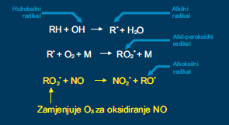
2.2 NO₂ – CHEMISTRY OF PRODUCTION AND DEGRADATION
European Union IPA 2013 Programme for Croatia
Summary cycle of organic radicals creation

Slide 48
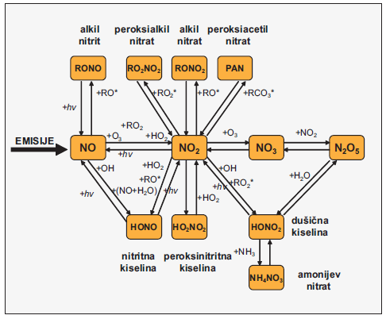
2.2 NO₂ – CHEMISTRY OF PRODUCTION AND DEGRADATION
European Union IPA 2013 Programme for Croatia
In photochemical reactions in the troposphere by oxidation of NO_{X}, products such as HNO₃, HO₂NO₂, HNO₂, peroxiacetyl nitrates, N₂O₅, nitrate radicals and organic nitrates are produced and all together represent biological irritants.

Slide 49
2.2 NO₂ – CHEMISTRY OF PRODUCTION AND DEGRADATION
European Union IPA 2013 Programme for Croatia
Summary the creation of photochemical smog
Photochemical smog is a mixture of primary and secondary pollutants in the troposphere.
Photochemical smog is created by a series reactions in which it transforms nitrogen (N) in the different compounds in the atmosphere.
3. Cars emit NO and small amounts of NO₂

Slide 50
2.2 NO₂ – CHEMISTRY OF PRODUCTION AND DEGRADATION
European Union IPA 2013 Programme for Croatia
Nitric oxide (NO) is actually the starting compound that is oxidized to atmospheric nitrogen dioxide (NO₂), and he is further oxidized to nitric trioksid (NO₃), which is transformed into nitric pentoksid (N₂O₅). Each of these nitrogen oxides then reacts in the photochemical processes with other atmospheric compounds, creating numerous biological irritants.
In the reactions of the creation of photochemical smog comes also to the deposition of ground-level ozone (O₃) in the lower layers of the troposphere
The resulting mixture of photochemical smog consists of more than 100 chemical compounds.

Slide 51
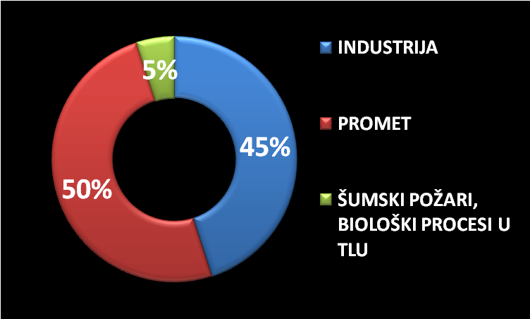
2.2 NO₂ – CHEMISTRY OF PRODUCTION AND DEGRADATION
European Union IPA 2013 Programme for Croatia
Natural and anthropogenic sources
INDUSTRY
TRAFFIC
FOREST FIRES, biological processes in soil

Slide 52
2.3 NO₂ – SPATIAL AND TEMPORAL DISTRIBUTION
European Union IPA 2013 Programme for Croatia
The types and concentrations of nitrogen compounds can vary a lot depending on:
Location
part of the day,
time of year
The main anthropogenic source of nitrogen oxides is combustion processes. Fossil fuels that burn in thermoelectric power plants, car engines and small household heating boilers emit nitrogen oxides most often in the form of nitrogen oxides (NO) and only 10% in the form of nitrogen oxides (NO₂).

Slide 53
2.3 NO₂ – SPATIAL AND TEMPORAL DISTRIBUTION
European Union IPA 2013 Programme for Croatia
Natural sources include volcanoes, forest fires, and biological processes in the soil which are released mainly nitrous oxide (N₂O). Processes in which it comes to the formation of NO₂, besides the combustion of fossil fuels, are nitrification and denitrification with the help of bacteria in the soil, as well as an electrical discharge in the atmosphere (the lightning).
The main mechanism of removal of nitrogen oxide in the atmosphere is HNO₃ oxidation followed by dry or wet deposition and the absorption of nitric acid in the soil.

Slide 54
2.3 NO₂ – SPATIAL AND TEMPORAL DISTRIBUTION
European Union IPA 2013 Programme for Croatia
Except that pollute the atmosphere, nitrogen compounds entered into the soil by artificial fertilizers in agriculture, pollute the soil and ground water system in which is entered from the soil leaching processes, so that it comes to the eutrophication of stagnant water (lakes), which become swamp.
Concentration in the air
According to the data of the (WHO) global annual average urban concentrations of NO₂ range between 20 and 90 μg/m³.
Long term monitoring of NO₂ in the air on a European stations shows a decrease of average annual concentrations by 12% in the period from 1997. to 2001.

Slide 55
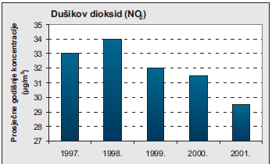
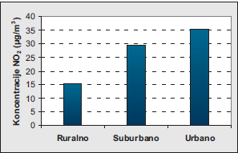
2.3 NO₂ – SPATIAL AND TEMPORAL DISTRIBUTION
European Union IPA 2013 Programme for Croatia
Average annual concentrations of NO₂ in Europe on the measuring stations AirBasea during the period from 1997. to 2001.
Source: AIRNET.
Average annual concentrations of NO₂ categorized according to the location of the measurement.
Source: AIRNET.

Slide 56
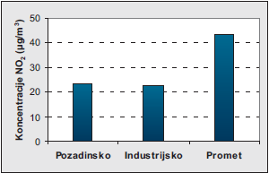
2.3 NO₂ – SPATIAL AND TEMPORAL DISTRIBUTION
European Union IPA 2013 Programme for Croatia
Average annual concentrations of NO₂ categorized according to a source of pollution. Source: AIRNET.
Background
Industrial
Traffic

Slide 57
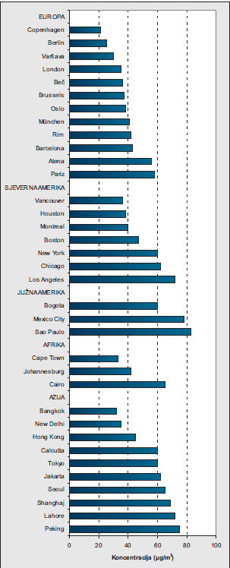
2.3 NO2 – SPATIAL AND TEMPORAL DISTRIBUTION
European Union IPA 2013 Programme for Croatia
Average annual concentrations of NO2 in the world in the period of 2002. to 2005. Source: Air quality guidelines – the WHO.

Slide 58
2.4 NO₂ – TOXICOLOGICAL AND PUBLIC HEALTH ASPECTS
European Union IPA 2013 Programme for Croatia
The path of entering NO₂ into the organism is a respiratory system.
It's very reactive, but poorly soluble in water, so its biological effects result primarily from his reaction with lipids and protein.
After inhalation 70 to 90% of gas is absorbed into the respiratory system. People who are physically active absorb an even higher percentage of NO₂ and it is transmitted to the lower parts of the respiratory system up to the pulmonary alveoli.

Slide 59
2.4 NO₂ – TOXICOLOGICAL AND PUBLIC HEALTH ASPECTS
European Union IPA 2013 Programme for Croatia
After entering the respiratory system NO₂ rapidly enters the bloodstream. Primary products found in the bloodstream are NO₂⁻ and NO₃⁻ ions that were created by dissociation of nitrogen and nitric acid formed in the NO₂ reaction with water in the tissues. Since NO₂ gas having an unpaired electron, giving it a free radical, is highly reactive and capable of oxidizing cellular molecules.
This property results in the creation of:
inflammatory processes in the tissues
cellular damage
lipids peroksidation
interaction with cellular proteins and thiols..
All of that damage lung tissue.

Slide 60
2.4 NO₂ – TOXICOLOGICAL AND PUBLIC HEALTH ASPECTS
European Union IPA 2013 Programme for Croatia
The ambient concentration of NO₂ do not cause negative health effects
The increased concentration in the range of 300 to 3000 μg/m³ that we find in the tunnels at the short-lived exposure can cause inflammatory reactions in the lung tissue, as well as a reduction in lung function
In patients with asthma and COPD, concentration of 190 μg/m³ can cause significantly narrowing of the airways

Slide 61
2.4 NO₂ – TOXICOLOGICAL AND PUBLIC HEALTH ASPECTS
European Union IPA 2013 Programme for Croatia
In patients with a mild form of asthma, 30-minute exposure to concentrations of 380 up to 560 μg/m³ may cause reversible decrease in lung function.
(The WHO Air quality guidelines, AIRNET).

Slide 62
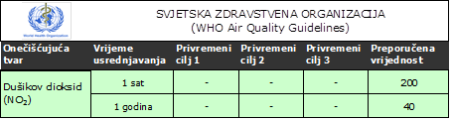
2.4 NO₂ – TOXICOLOGICAL AND PUBLIC HEALTH ASPECTS
European Union IPA 2013 Programme for Croatia
Recommended values (μg/m³), for concentration of nitrogen dioxide (NO₂) in the air-the WHO
Pollutant
Averaging time
Temporary goal 1
Temporary goal 2
Temporary goal 3
Recommended value
hour
year

Slide 63
2.5 NO₂ – MEASUREMENT METHODS
European Union IPA 2013 Programme for Croatia
The reference method for the measurement of the NO and NO₂
chemiluminescence
(HRN EN 14211)
Prescribed by regulations of the Republic of Croatia and the European Union. In the European Union and Croatia was adopted by 2012.

Slide 64
2.5 NO₂ – MEASUREMENT METHODS
European Union IPA 2013 Programme for Croatia
The fundamental principle of chemiluminescence is the emission of energy (radiation) that is the result of some chemical reaction that occurs in this case due to the reaction of nitrogen oxide with ozone:
NO + O₃  NO₂* + O₂
[1]
NO₂*  NO₂ + hv
[2]
In reaction [1] nitric oxide is generated in the excited energy state (NO₂ *) which is then returned to normal state [2] by release of energy whose intensity is proportional to the concentration of NO from the reaction [1].

Slide 65
2.5 NO₂ – MEASUREMENT METHODS
European Union IPA 2013 Programme for Croatia
The energy emitted by this reaction is in the near infrared part of the spectrum (600-3000 nm) with a strong intensity of about 1200 nm. The emitted energy is filtered using selective optical filters and then converted to an electric signal with the aid of a photoconductor or photodiode. The electrical signal is then measured and its intensity is proportional to the NO concentration that has entered the reaction [1].
In the chemiluminescent analyzer, the air flows through the reaction cell at constant speed with optimized conditions and the presence of excess ozone. This ensures complete reaction.

Slide 66
2.5 NO₂ – MEASUREMENT METHODS
European Union IPA 2013 Programme for Croatia
In the process of determining the concentration of nitrogen dioxide (NO₂) the air is first passed through a catalytic converter where all NO₂ converts to NO:
NO₂ --------catalytic conversion--------NO
[3]
Thus, NO represents the sum of NO from the air and the NO generated by the conversion from NO₂ and we call it NO_{X}. NO passes through the reaction cell and the concentration is determined as described above. By the alternating passage of sampled air through the passing cell and without passing through the converter, the concentrations of NO and NO_{X} (NO + NO₂) in the air are obtained. The difference between these concentrations is the concentration of NO₂ in the air:

Slide 67
2.5 NO₂ – MEASUREMENT METHODS
European Union IPA 2013 Programme for Croatia
NO_{x} – NO = NO₂
[4]
If the instrument is calibrated in volume / volume units, NO and NO₂ concentrations are directly measured in volume / volume units (ppb) since the chemiluminescence intensity is proportional to the NO concentration in volume / volume units.
After that, the obtained concentrations in ppb are converted to μg/m³ using the standard conversion factors for a temperature of 20 ° C and an atmospheric pressure of 1013 hPa.
1ppb (nmol/mol) NO = 1,25 μg/m³ NO

Slide 68
THANK YOU FOR YOUR ATTENTION !
Disclaimer: The contents of this publication are the sole responsibility of EKONERG – Energy Research and Environmental Protection Institute, Ltd. and can in no way be taken to reflect the views of the European Union
This project is funded by the European Union

